Slide 1
Why and When will Leaders of Developing County Negotiate South-North Preferential Trade Agreements?
Lucie Lu
Department of Political Science
Notes:
Hi

Slide 2
Research Question
Empirical Puzzle: PTA negotiation between South Africa and the EU in 1994
Research Question: Why and when will leaders in the developing country negotiate South-North preferential trade agreements with provisions of economic reforms?
Why important?
PTA is a rapidly growing international institution
How international institution shapes domestic politics

Slide 3
Context and Rationale
Two themes in the literatures:
Effects vs. Causes of PTAs.
What are the gaps in the literature?
Treat PTA as unit of analysis
Overlook key actor: opposition
Regime types matter (Mansfield & Milner, 2012; Mansfield, Milner, & Rosendorff, 2002).
Interest groups matter (Grossman and Helpman, 1995).
Private sectors matter (Staiger & Tabellini, 1999).

Slide 4
Argument
Leaders negotiate PTAs for political reason: A leader negotiates a PTA with the provision of economic reform to punish the opponents’ past transgression.
PTA negotiation is a deliberate choice that a leader makes to commit to the binding and stringent policy reforms to rearrange the domestic power structures.

Slide 5
Theory
(I) The Logic of Economic Reforms
In non-crisis circumstances:
Leader: repression or loyalty
Opposition: cooperation or deposition
A shock to security has happened (opposition defects):
the threatening demands on a regime by opposition groups
such as strikes, protest demonstrations, riots, guerillas and civil war
Story begins in the post-crisis circumstances:
Leader: repress more or economic reform
Opposition: cooperation or deposition
(II) Why negotiating a PTA with major liberal powers?
A signal to the opposition: decrease the likelihood of deposition
Offering material benefits to facilitate economic reforms

Slide 6
Research Design
Hypothesis:
Negative shocks to a leader's security increase the probability of PTA negotiations.
(Hypothetical Treatment)
Shock to Leader’s Security
+
South-North PTA Negotiation
Research Design:
Compares the likelihoods of the South-North PTAs negotiation in:
Leaders with Shocks to Security
Leaders without Shocks to Security

Slide 7
Research Design
Measure the security of a leader for all leaders:
1) A leader's security before he starts his tenure at time 0 (regime type matters);
2) The security of the regime at time t.
Shocks to Leaders’ Security (Hypothetical Treatment):
Type 1: a leader experiences a shock to security at time 1.
political effectiveness score 2 and 3.
Type 2: a leader experiences a shock to security at time t.
worsening political effectiveness score.

Slide 8
Who are in Which Group?
Scenarios of Leaders | Chan-ges in P. Eff | Shock | Gr. | Dem. | Aut.
secure all the time at t₀, t_{1 …} t_{n} |  |  | C | ☒ | ☒
insecure all the time at t₀, t_{1 …} t_{n} |  |  | C |  | ☒
secure at t₀ ➔ insecure at t_{1, …,} t_{n} | ☒ | shock at t₁ | T | ☒ | ☒
secure at t_{0,} t_{1, …} ➔ insecure at t_{n} | ☒ | shock at t_{n} | T | ☒ | ☒
insecure at t_{0 ,} t_{1, …} ➔ (more) insecure at t_{n} | ☒ | shock at t_{n} | T |  | ☒
insecure at t_{0 ,} t_{1, …} ➔ secure at t_{n} | ☒ |  | C |  | ☒
secure at t₀ ➔ insecure at t_{1, …} ➔ secure at t_{n} | ☒ |  | C | ☒ | ☒

Slide 9
Examples in Datasets
Unit of analysis: Leader-Year
Coun-try | Ye-ar | Lea-der | Reg-ime | R.T. Past | P. Eff | PTA nego
Albania | 1995 | Berisha | Dem. | NA | 1 | 0
Albania | 1996 | Berisha | Dem. | NA | 1 | 0
Albania | 1997 | Berisha | Dem. | NA | 1 | 0
Albania | 1997 | Fatas | Dem. | NA | 1 | 0
Albania | 1998 | Fatas | Dem. | NA | 2 | 0
Albania | 1999 | Meta | Dem. | NA | 2 | 0
Albania | 2000 | Meta | Dem. | NA | 2 | 0
Albania | 2001 | Meta | Dem. | NA | 2 | 0
Albania | 2002 | Meta | Dem. | NA | 2 | 1
 |  |  | . . .
Algeria | 1995 | Zeroual | Dict. | Regime | 2 | 0
Algeria | 1996 | Zeroual | Dict. | Regime | 2 | 1
Algeria | 1997 | Zeroual | Dict. | Regime | 2 | 0
Algeria | 1998 | Zeroual | Dict. | Regime | 2 | 0
Algeria | 1999 | Zeroual | Dict. | Regime | 2 | 0
Egypt | 2013 | Mansour | Dict. | Opposit-ion | 2 | 0
Egypt | 2014 | Mansour | Dict. | Opposit-ion | 2 | 0
Nambia | 2005 | Pohamb | Dict. | Opposit-ion | 0 | 0
Nambia | . . . | Pohamb | Dict. | Opposit-ion | . . . | . . .
Nambia | 2015 | Pohamb | Dict. | Opposit-ion | 0 | 0
Unit of analysis: Leader
(Main dataset)
e
Cou-ntry | Leader | Te-nure | Reg-ime | R.T. Past | P. Eff | Shock (Z) | PTA nego
Albania | Berisha | 3 | Dem. | NA | ins_all | 0 | 0
Albania | Fatas | 2 | Dem. | NA | shock_t | 1 | 0
Albania | Meta | 4 | Dem. | NA | shock_t1 | 1 | 1
 |  |  | . . .
Algeria | Zeroual | 6 | Dict. | Regime | shock_t1 | 1 | 1
Egypt | Mansour | 2 | Dict. | Opposi-tion | ins_all | 0 | 0
Nambia | Pohamb | 11 | Dict. | Opposi-tion | s_all | 0 | 0

Slide 10
Research Design
Unit of analysis is leader.
The dataset covers 286 leaders in 62 developing countries in the period 1995 to 2015.
Dependent Variable: South-North PTA negotiation
Independent Variable: Shocks to Security
Matching on the Covariates:
Regime Type (V-Dem’s)
Human Rights Conditions (PTS score)
Regime Duration
GDP per capita
Confounding Variables in the OLS Model:
Leaders’ tenure
Economic Recession (Negative Economic Growth)

Slide 11
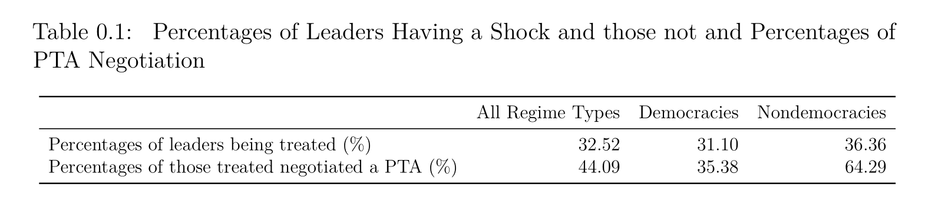
Empirical Findings: Data Description

Slide 12
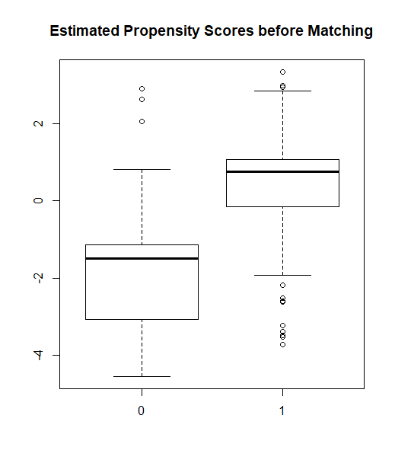
Empirical Findings: Propensity Score Before Matching

Slide 13
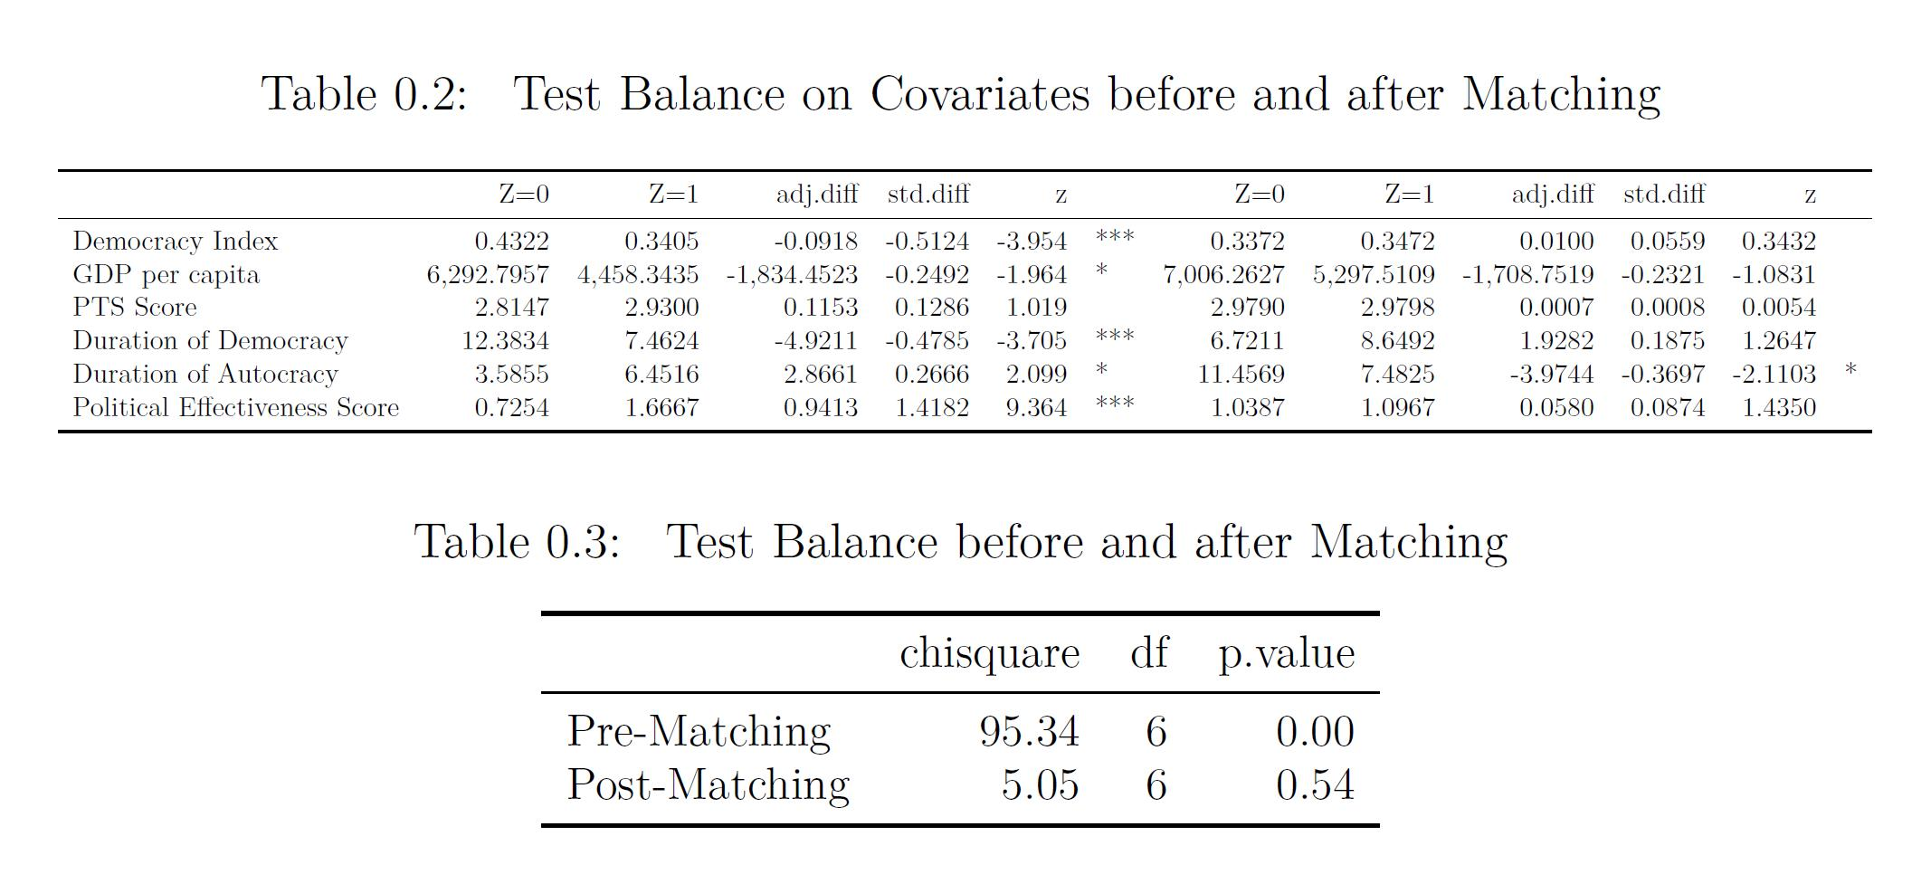
Empirical Findings: Propensity Score After Matching

Slide 14
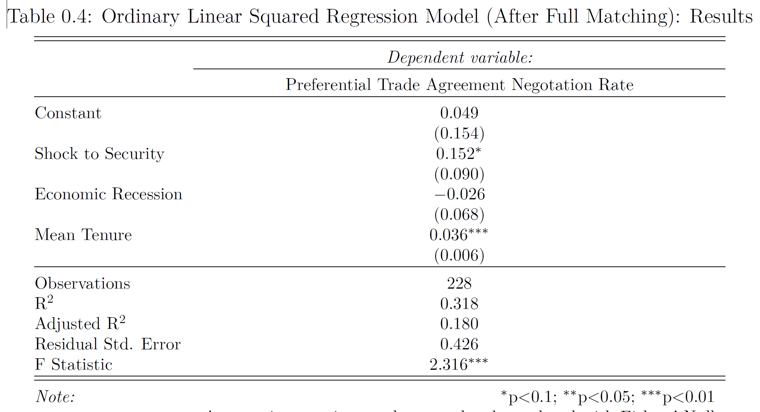
Empirical Findings: Treatment Effect After Matching

Slide 15
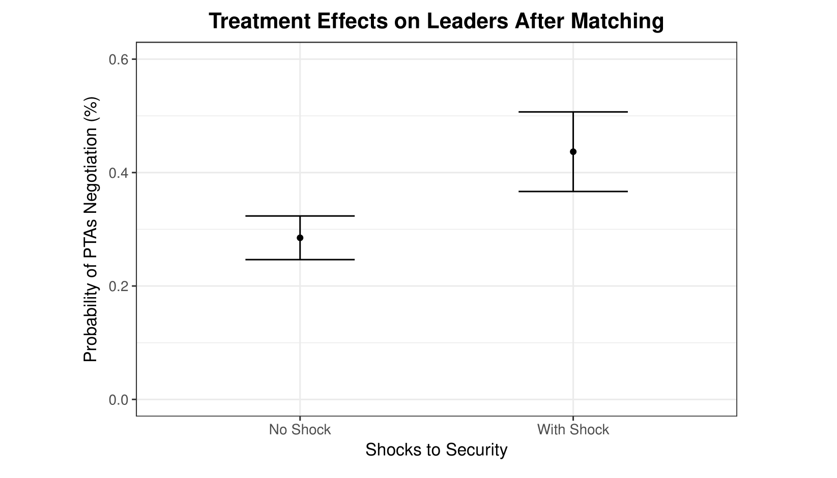
Empirical Findings: Treatment Effect After Matching

Slide 16
Conclusion
My hypothesis is empirically supported:
When leaders experience political crisis, they are more likely to negotiate a South-North preferential trade agreement with the provision of economic reforms.
Moving forward:
Explore whether PTA negotiation helps leaders to conduct economic reforms.
Notes:
hello

Slide 17
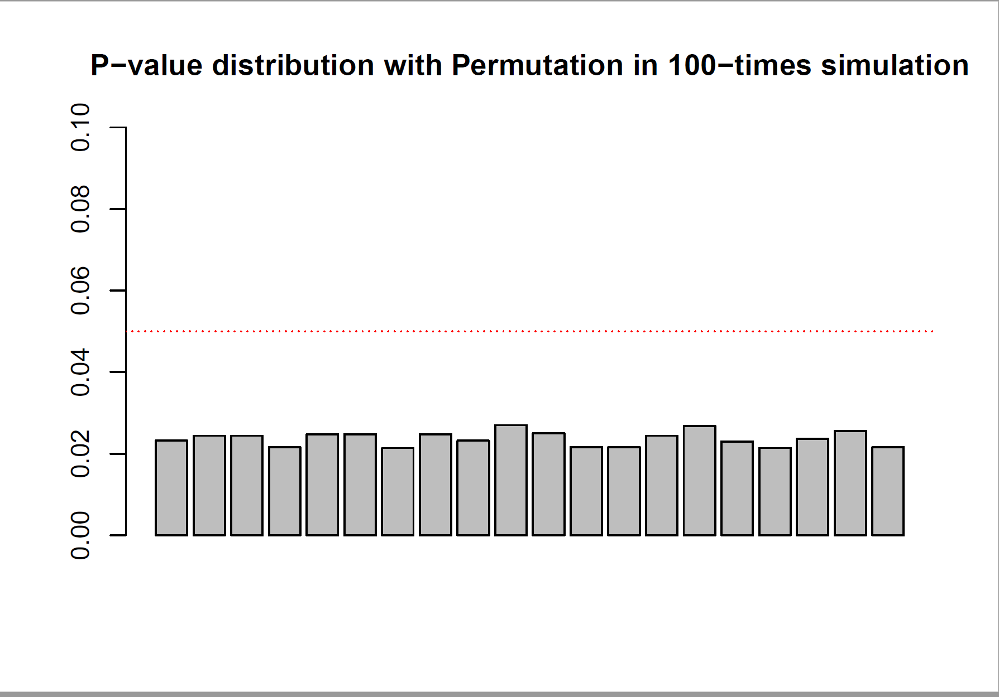
Appendix
Notes:
hello

Slide 18
References
Baccini, L., & Urpelainen, J. (2014). International Institutions and Domestic Politics: Can Preferential Trading Agreements Help Leaders Promote Economic Reform? The Journal of Politics, 76(1), 195–214. https://doi.org/10.1017/S0022381613001278
Bagwell, K., & Staiger, R. W. (1998). Will Preferential Agreements Undermine the Multilateral Trading System? The Economic Journal, 108(449), 1162–1182. https://doi.org/10.1111/1468-0297.00336
Baldwin, R. E. (2012). A Domino Theory of Regionalism. In G. Hufbauer & K. Suominen (Eds.), The Economics of Free Trade. Volume 2. (pp. 416–439). Elgar Research Collection. The International Library of Critical Writings in Economics, vol. 262. Cheltenham, U.K. and Northampton, Mass.: Elgar.
Bilal, S., & Laporte, G. (2004). How David Prepared to Talk to Goliath? South Africa’s experience of negotiating trade with the EU.
Dür, A., Baccini, L., & Elsig, M. (2014). The Design of International Trade Agreements: Introducing a New Dataset. The Review of International Organizations, 9(3), 353–375. https://doi.org/10.1007/s11558-013-9179-8
Grossman, G. M., & Helpman, E. (1995). The Politics of Free-Trade Agreements. The American Economic Review, 85(4), 667–690.
Kuran, T. (1991). Now out of Never: The Element of Surprise in the East European Revolution of 1989. World Politics, 44(01), 7–48. https://doi.org/10.2307/2010422
Mansfield, E. D., & Milner, H. V. (2012). Votes, Vetoes, and the Political Economy of International Trade Agreements. Princeton University Press. Retrieved from https://muse-jhu-edu.proxy2.library.illinois.edu/book/30505
Mansfield, E. D., Milner, H. V., & Rosendorff, B. P. (2002). Why Democracies Cooperate More: Electoral Control and International Trade Agreements. International Organization, 56(3), 477–513.
Mansfield, E. D., & Reinhardt, E. (2003). Multilateral Determinants of Regionalism: The Effects of GATT/WTO on the Formation of Preferential Trading Arrangements. International Organization, 57(4), 829–862.
Regan, P. M., & Henderson, E. A. (2002). Democracy, threats and political repression in developing countries: Are democracies internally less violent? Third World Quarterly, 23(1), 119–136. https://doi.org/10.1080/01436590220108207
Rodrik, D. (1992). The Rush to Free Trade in the Developing World: Why So Late? Why Now? Will it Last? (No. w3947). Cambridge, MA: National Bureau of Economic Research. https://doi.org/10.3386/w3947
Schamis, H. E. (1999). Distributional Coalitions and the Politics of Economic Reform in Latin America. World Politics, 51(2), 236–268. https://doi.org/10.1017/S0043887100008182
Staiger, R. W., & Tabellini, G. (1999). Do Gatt Rules Help Governments Make Domestic Commitments? Economics & Politics, 11(2), 109–144. https://doi.org/10.1111/1468-0343.00055
Wintrobe, R. (1998). The political economy of dictatorship /. Cambridge, UK ; Cambridge University Press,.

